Slide 1
oqyrman
The e-book reader platform
development in Kazakh language
Rsaliyev Zhomart

Slide 2
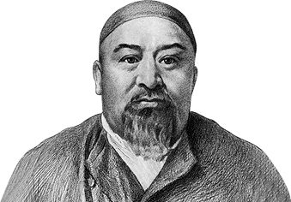
YOU – ARE A LITTLE BRICK IN THE WALL OF THE WORLD.
FIND YOUR PLACE IN IT.
•
ABAI QUNANBAIULY

Slide 3
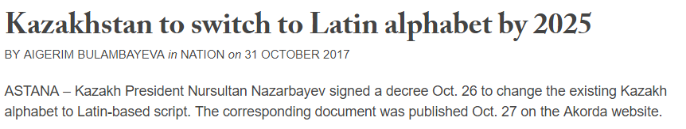

Slide 4
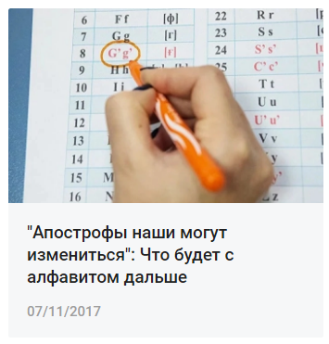
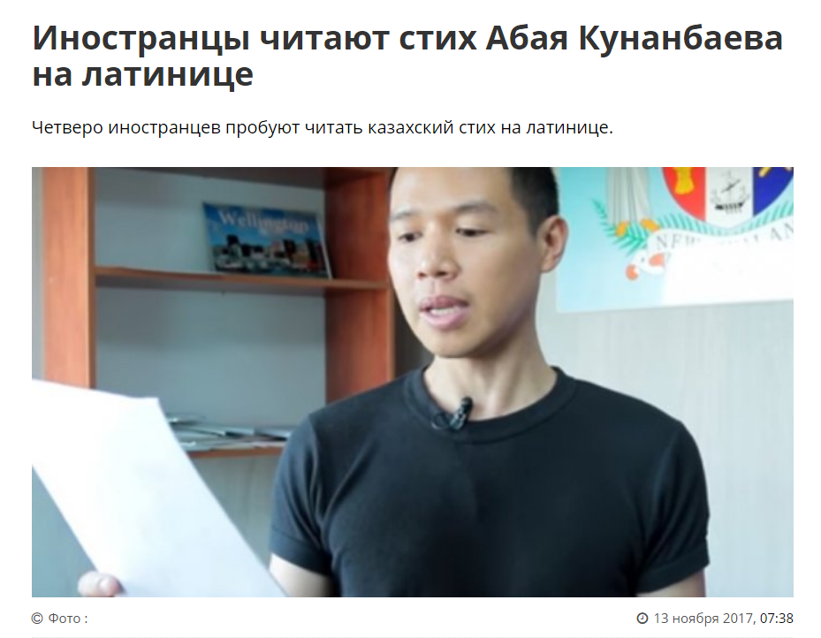
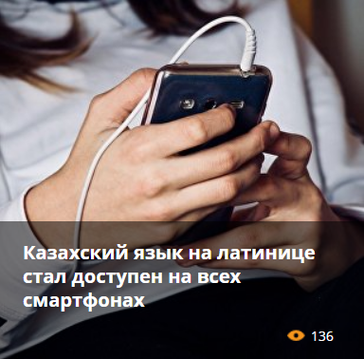
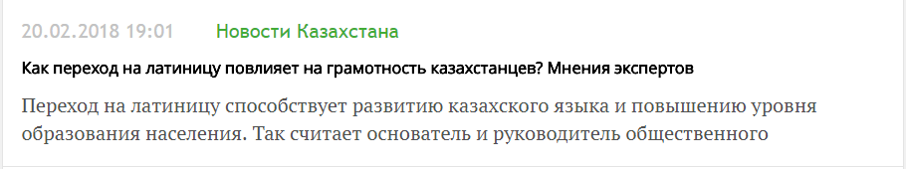
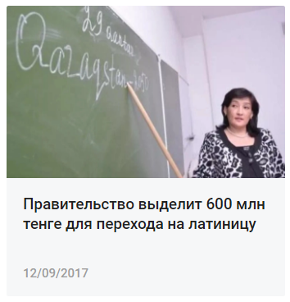
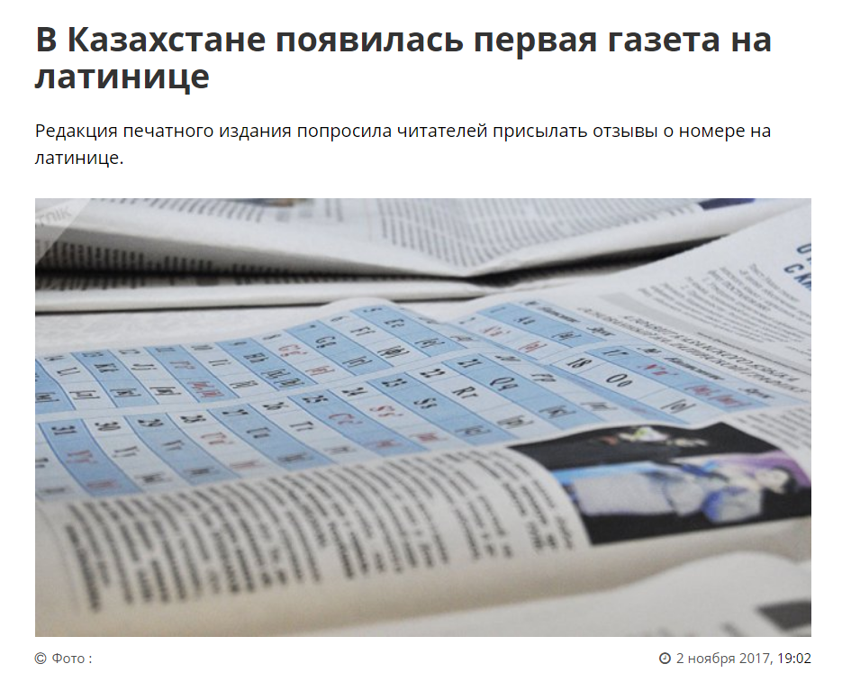
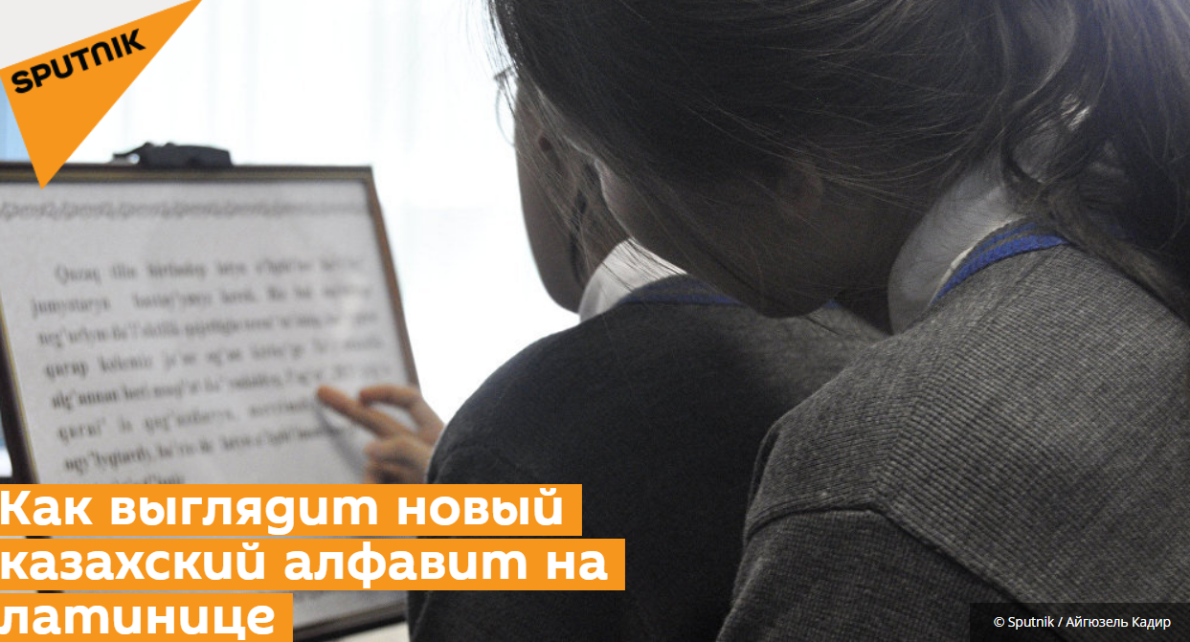
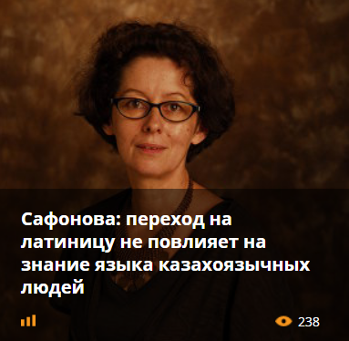
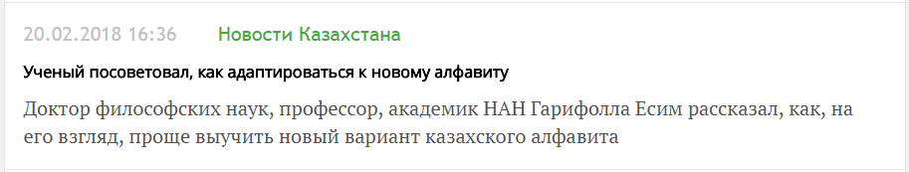

Slide 5
1.
Digraph
2.
Apostrophe
3.
Acute accent

Slide 6
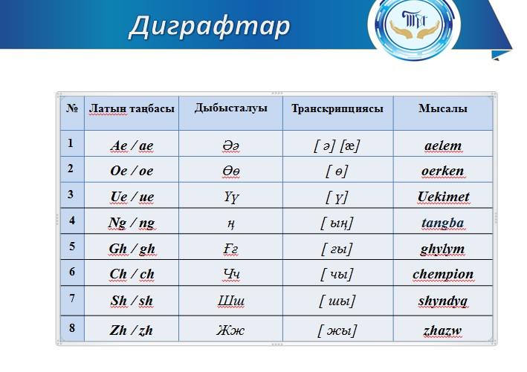
Digraph
a pair of characters used together to represent a single sound, such as "sh" in English
Consists of 25 letters and 8 digraphs

Slide 7
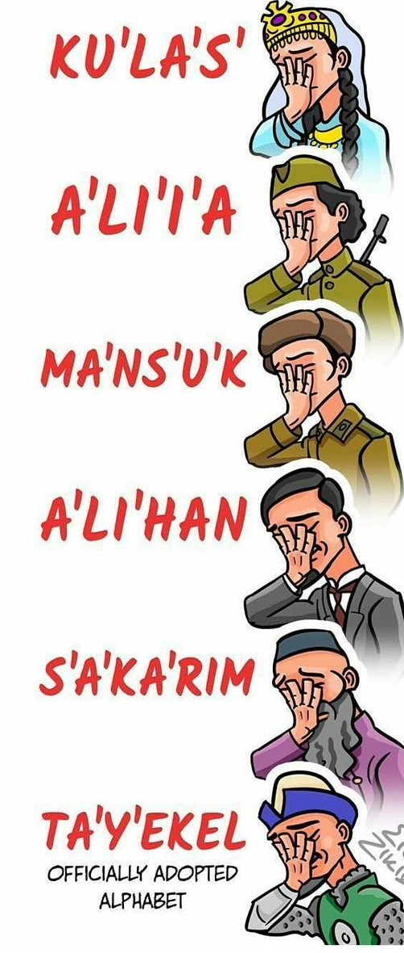

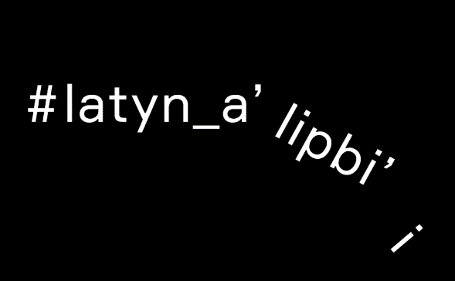
Apostrophe
Consists of 32 letters, 9 of them are written with apostrophe

Slide 8
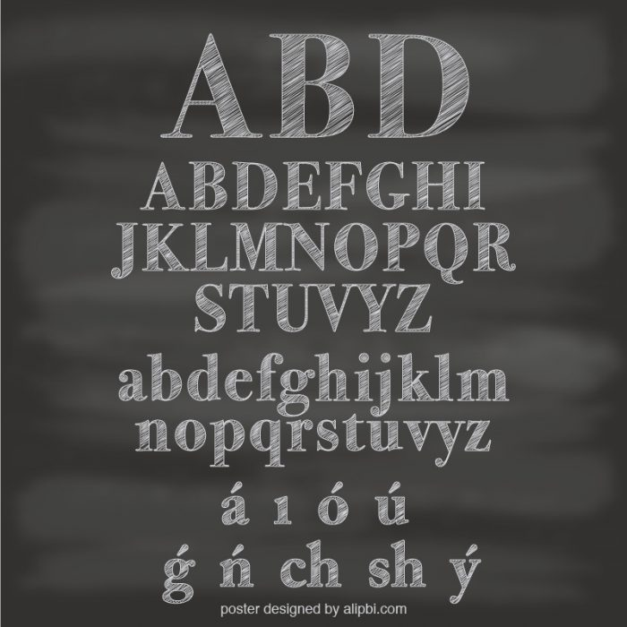
Acute accent
Consists of 24 Latin letters and 6 new letters
Closer to Turkic languages
Comfortable

Slide 9
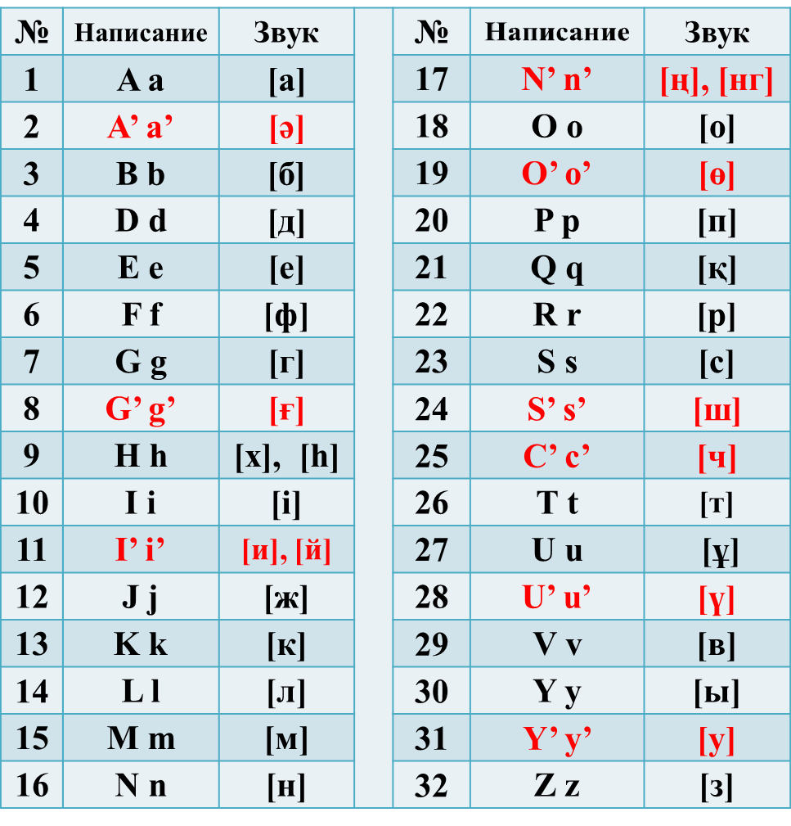
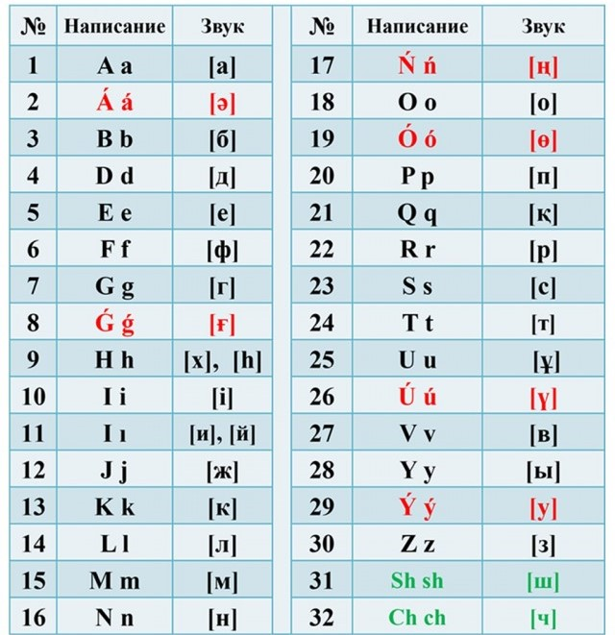
Comparison(Latin v2.0 with Latin v3.0)

Slide 10
Motivation
Adaptation
Help the nation with the adaptation
Expenditure
Show how the project does not need much money
Content-making
Raise the level of content-making in Kazakhstan

Slide 11
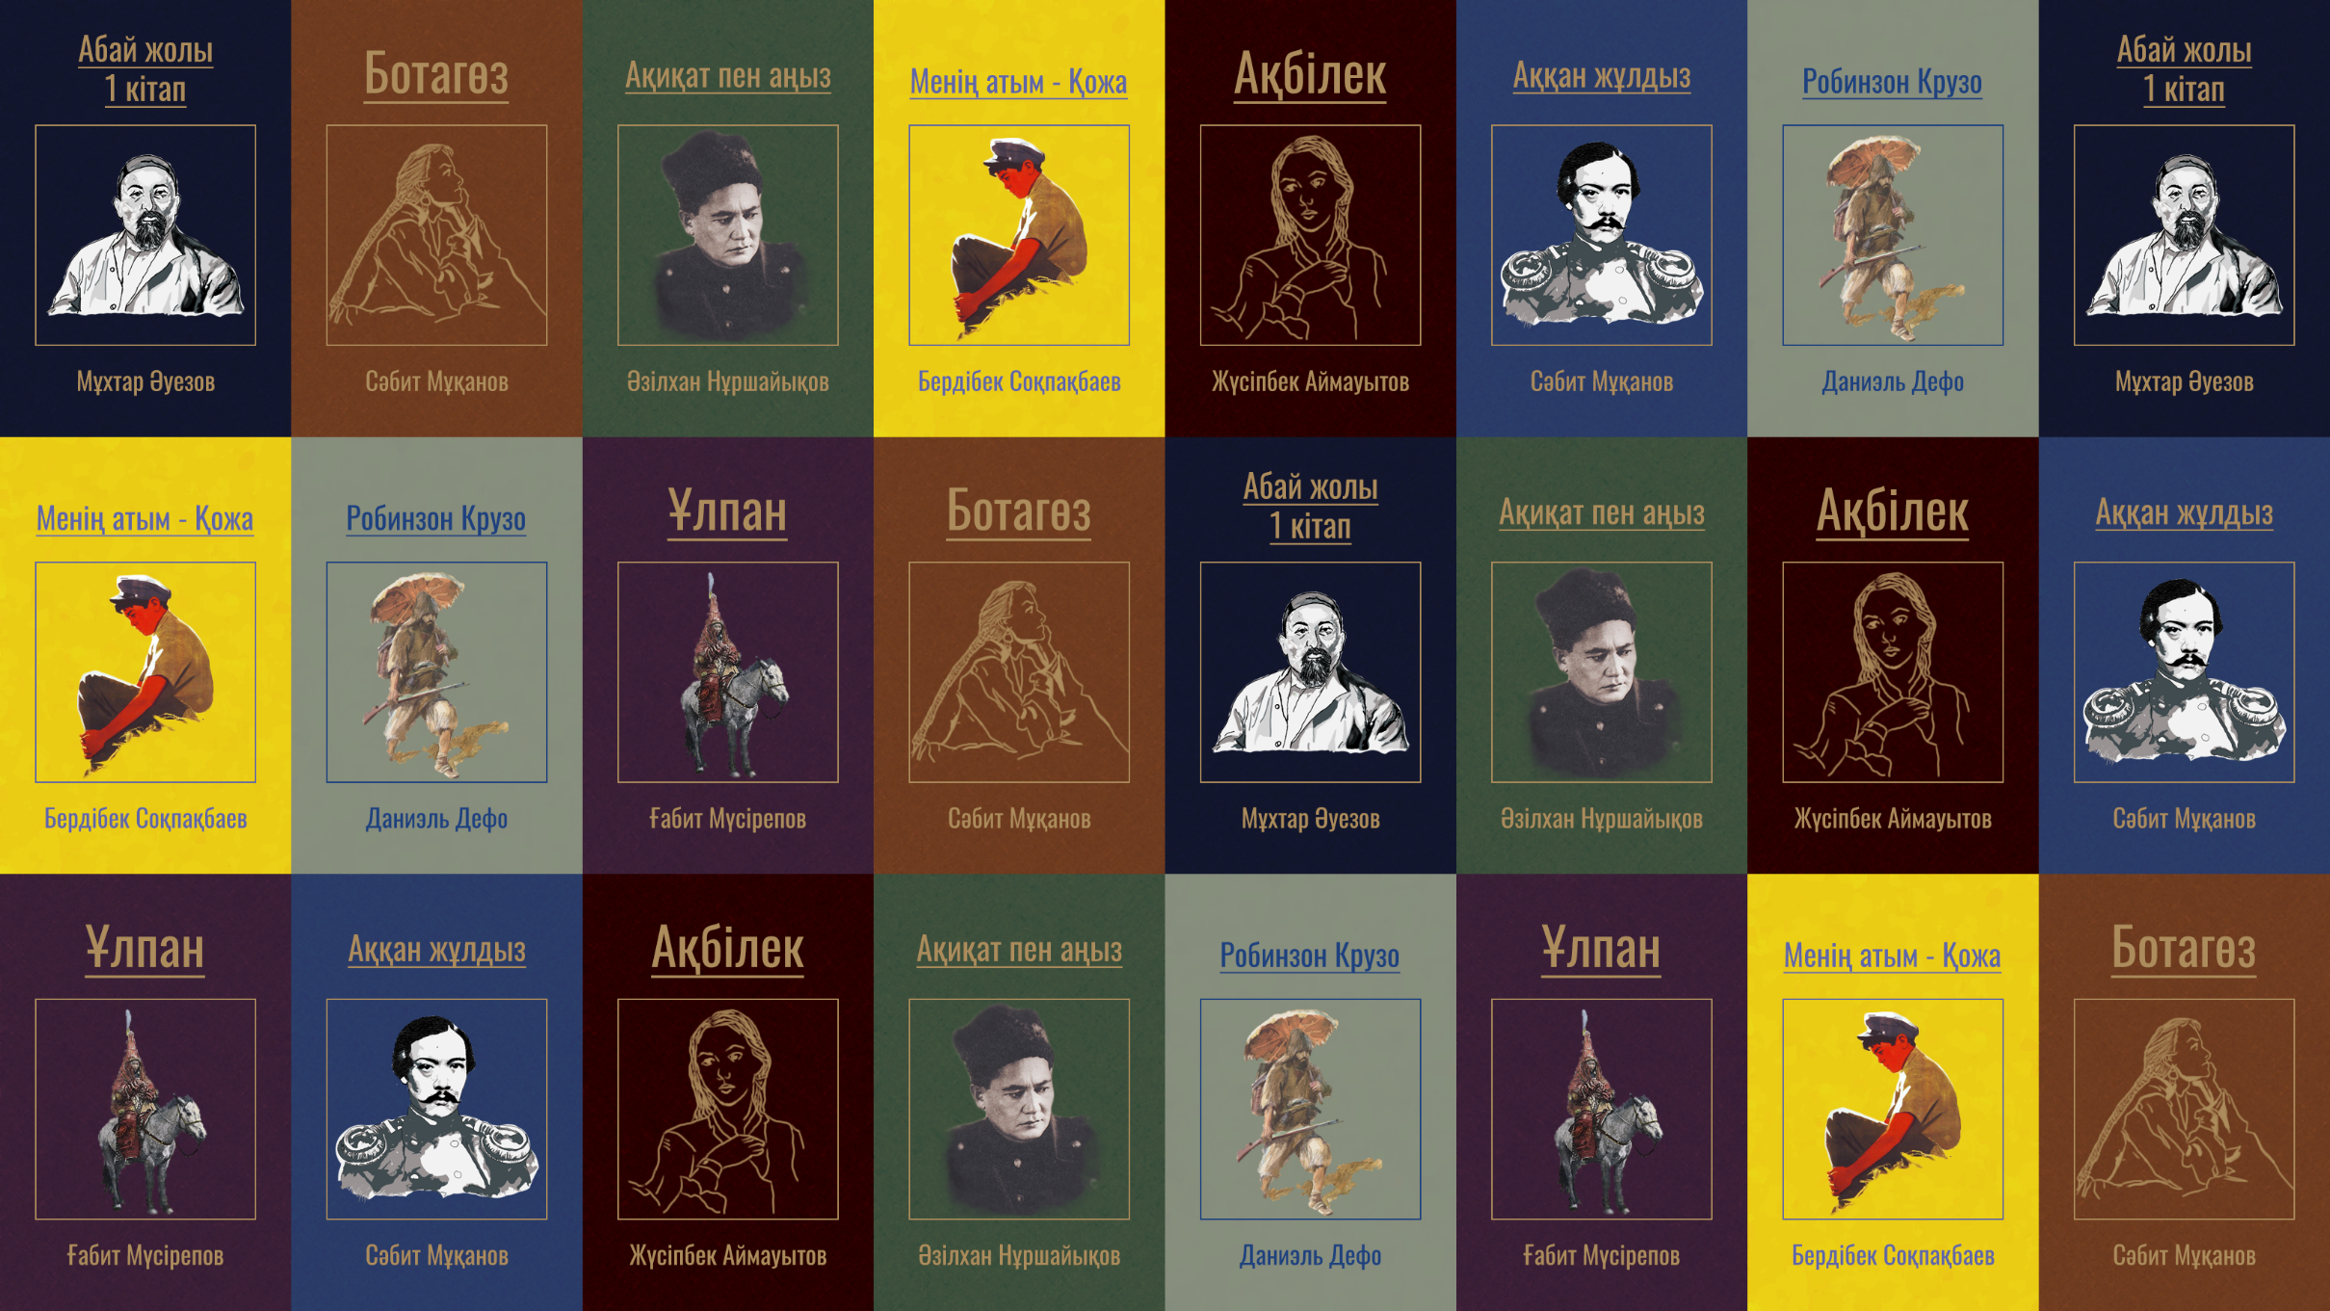

Slide 12

oqyrman
django

Slide 13
Django
back-end
Django makes it easier to build better Web apps more quickly and with less code.

Slide 14
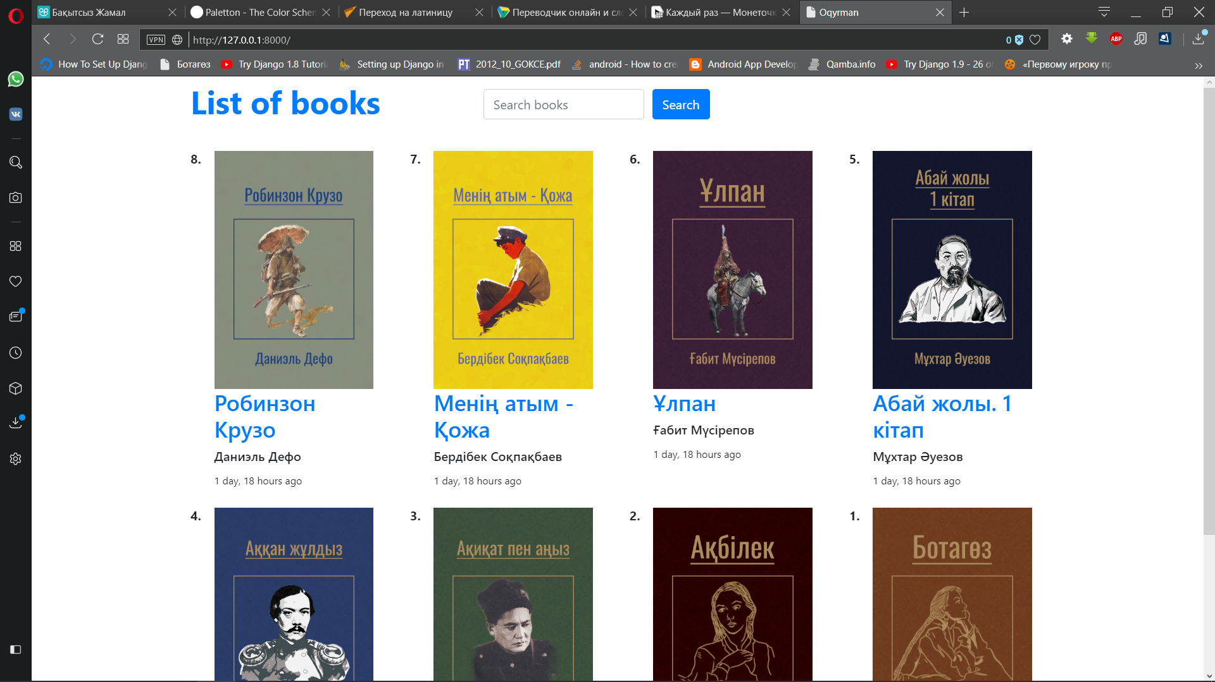

Slide 15
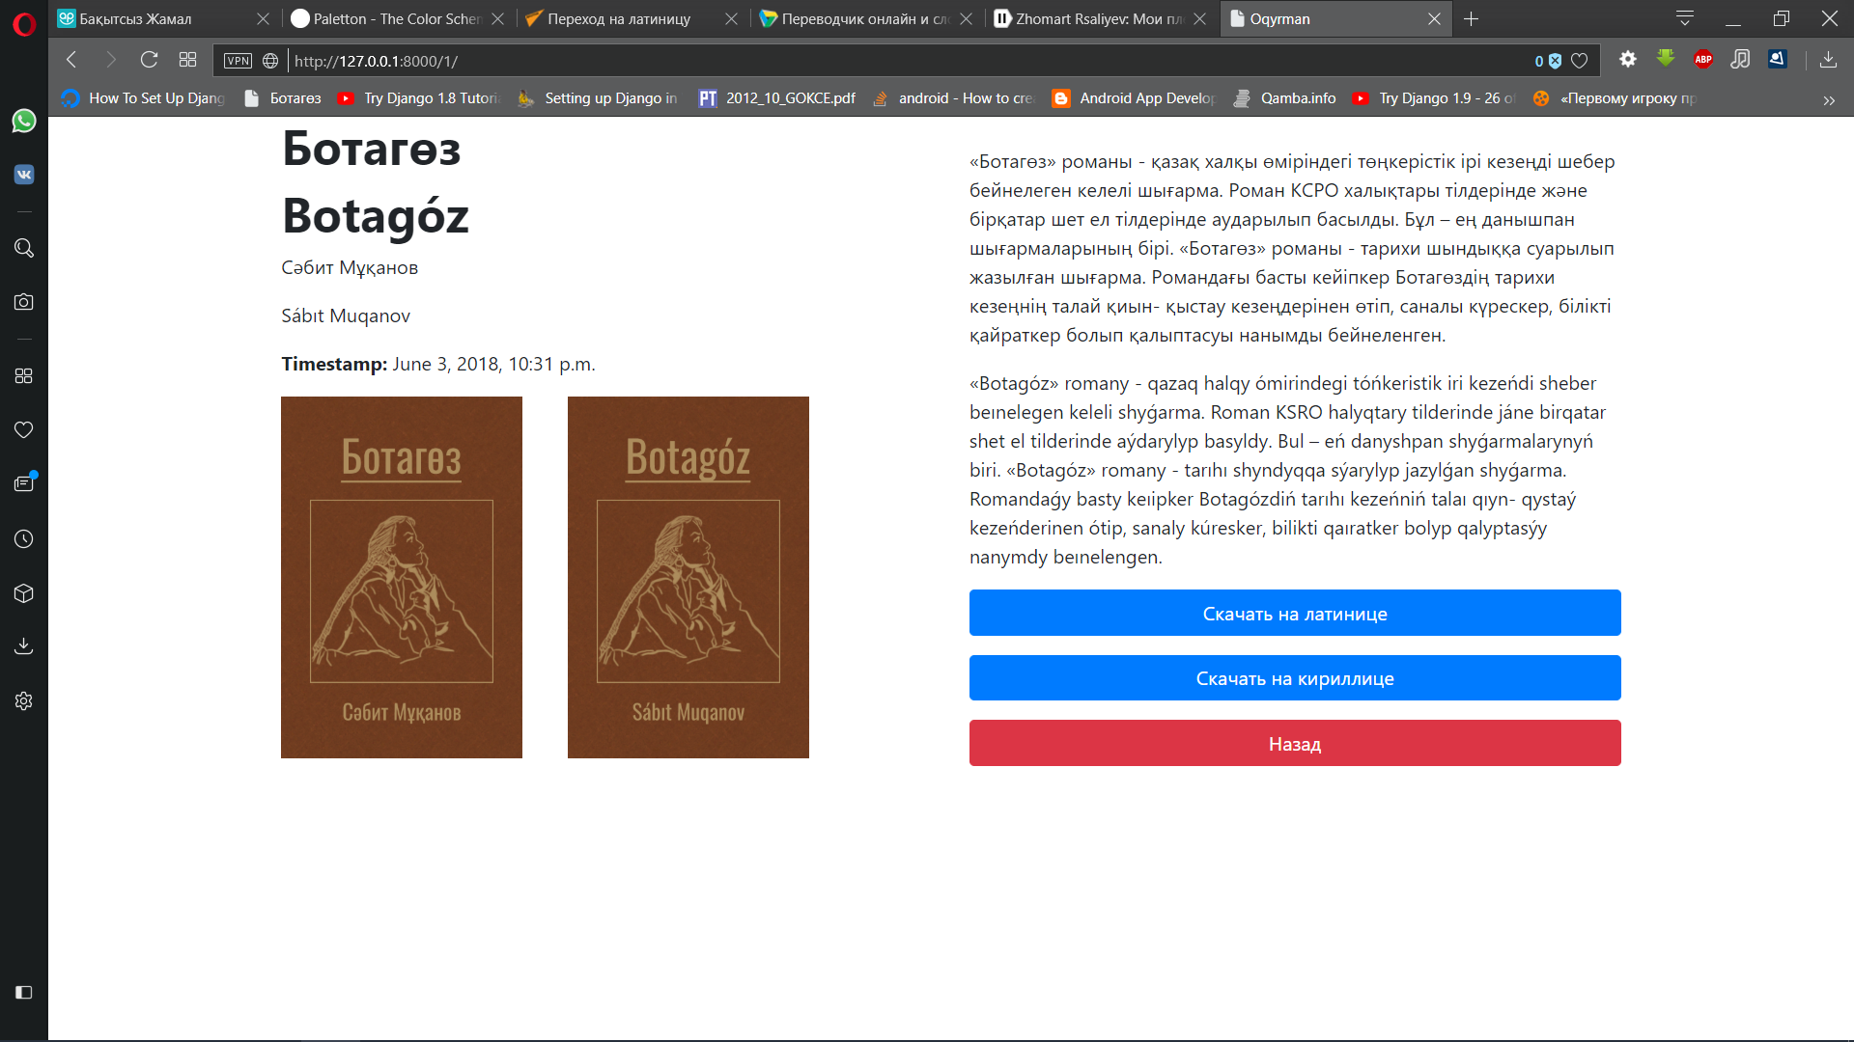

Slide 16
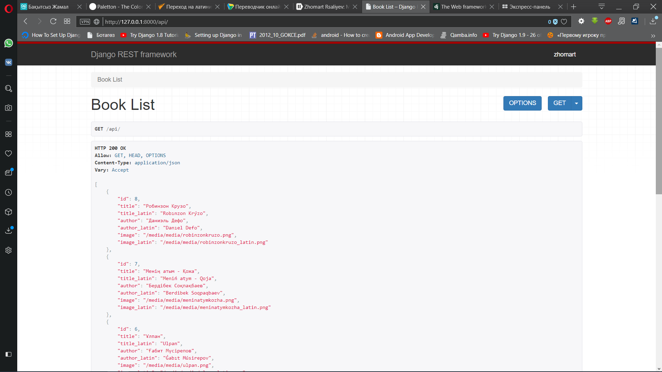

Slide 17
Android
front-end
The world’s most popular mobile OS

Slide 18
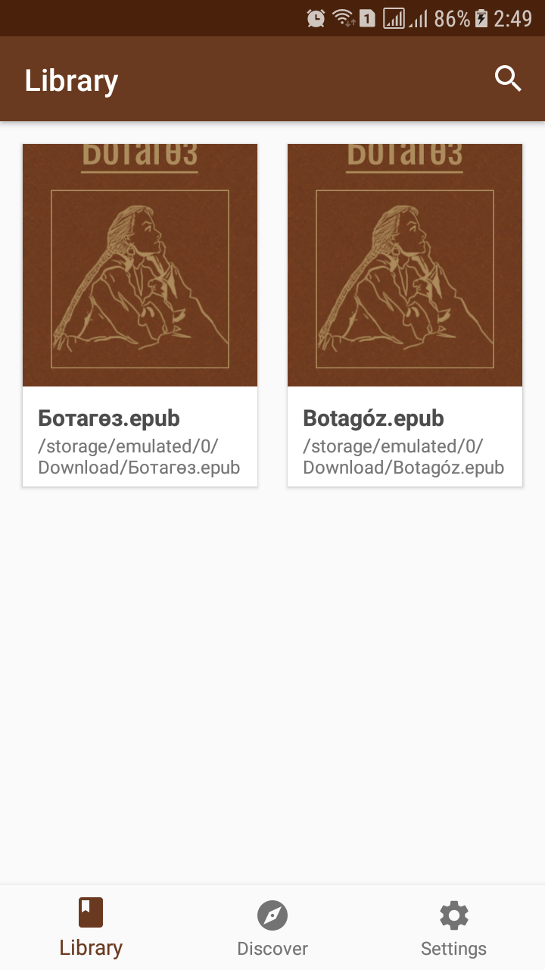
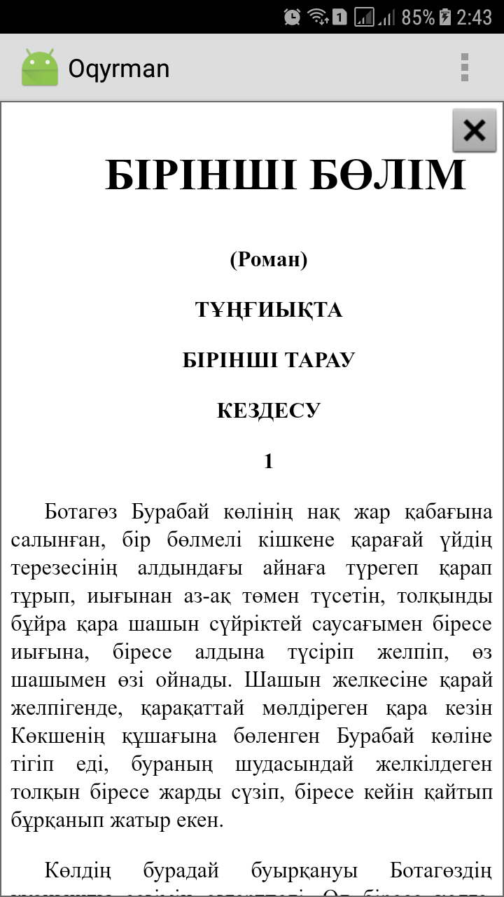
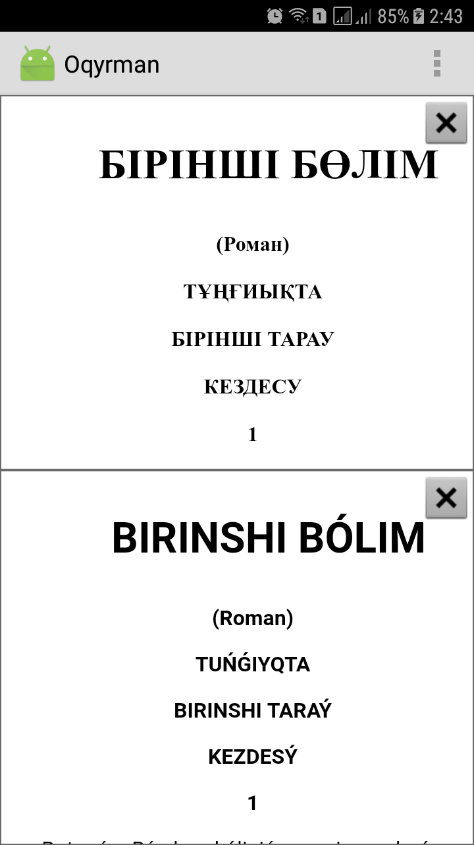

Slide 19
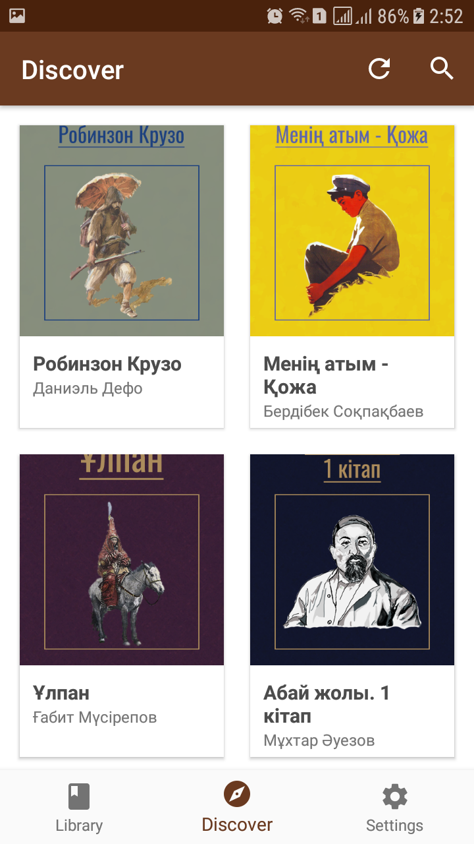
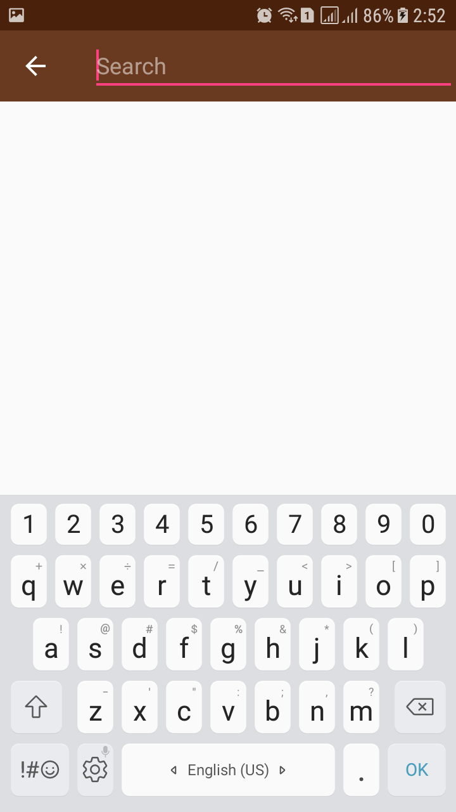
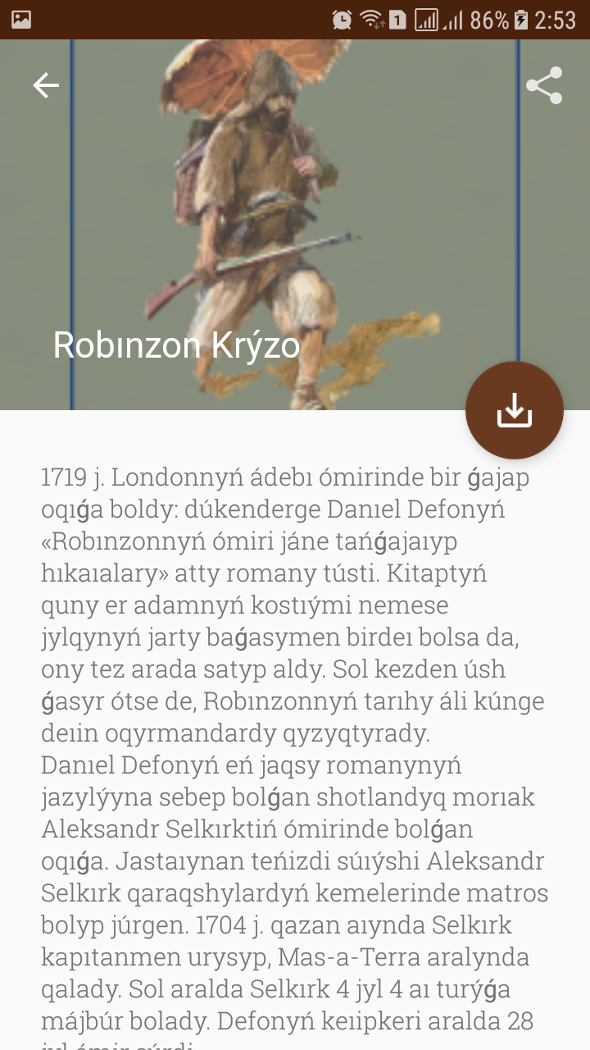

Slide 20
